Slide 1

Casual Riders vs. Members
How do they differ?
Lee Crowther
Cyclistic
26 June 2022

Slide 2
Agenda
Project Description
Data
Methodology
Findings
Summary and Recommendations
Questions and Discussion

Slide 3
Project Description
Task
Determine how annual members and casual riders use Cyclistic bikes differently
Purpose
Convert casual riders into annual members.

Slide 4
Data
Data Source
Data for June 2021–May 2022 was downloaded from https://divvy-tripdata.s3.amazonaws.com/index.html.
License
https://ride.divvybikes.com/data-license-agreement

Slide 5
Methodology
Steps
Adapted R script created to look at earlier data (https://docs.google.com/document/d/1TTj5KNKf4BWvEORGm10oNbpwTRk1hamsWJGj6qRWpuI/edit)
Used script to clean data and summarize by ride counts, ride length, days of the week, months, and ride locations
Use Excel to combine summaries and for further analysis and visualization.

Slide 6
Methodology
Assumptions
Findings would also apply to other years
Limitations
Can’t distinguish between full-day passes and single-ride passes
Can’t tell which riders live in the area and which don’t

Slide 7
Findings
How much do they ride?
How long are their rides?
When do they ride most?
Where do they ride?

Slide 8
How much do they ride?
Members go on 29% more rides.
Casual riders spend 92% more time riding.

Slide 9
How long are their rides?
User Type | Average Ride Length
Casual Riders | 32:34
Members | 13:10

Slide 10
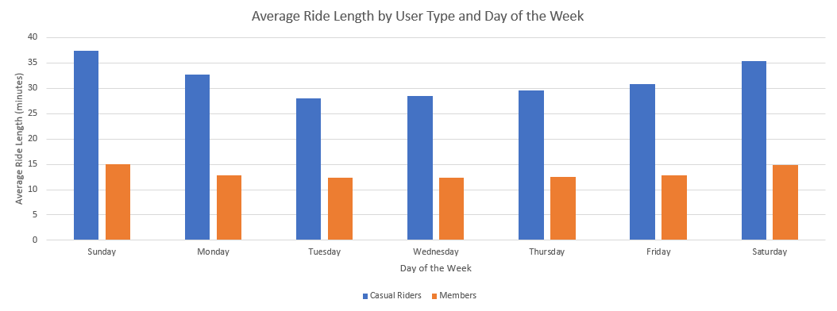
How long are their rides?

Slide 11
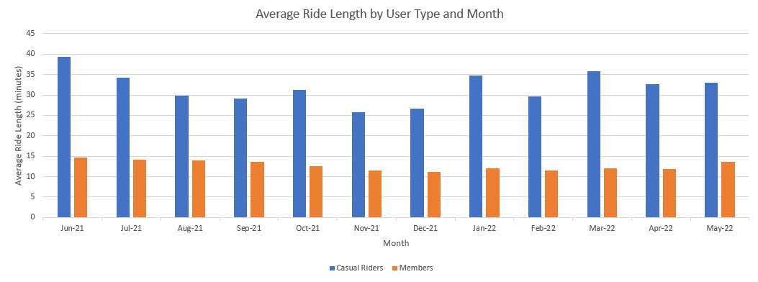
How long are their rides?

Slide 12
How long are their rides?
Summary
Members go on more, but shorter, rides.
Casual riders go on fewer, but longer rides.
Casual riders spend more overall time riding.
Recommendation
Offer membership deals to people who go on longer rides.

Slide 13
When do they ride most?
 | Casual Riders | Members
Days of the week | Weekends | Every day
Months of the year | June–September (# of rides) June–August (ride time) | May–October

Slide 14
When do they ride most?

Slide 15
When do they ride most?

Slide 16
When do they ride most?
Summary
Members ride similar amounts every day of the week.
Casual riders are much more active on weekends.
Members have a longer peak activity window (6 months) than casual riders (3–4 months).
Recommendation
Focus casual rider-targeted advertising efforts on weekends and summer.

Slide 17
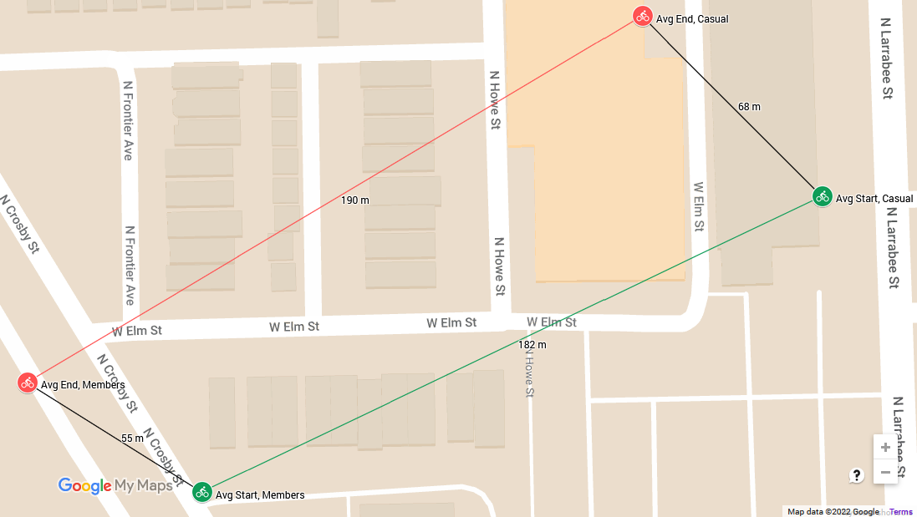
Where do they ride?
Trivial differences in avg starting and ending coordinates—all within ≈200 m

Slide 18
Where do they ride?
However, differences at station level
Most Common Start Stations for Casual Riders Relative to Members*
Start Station | Casual Rides ÷ Member Rides
Buckingham Fountain | 5.43
Shedd Aquarium | 4.71
Field Museum | 4.15
Street Dr & Grand Ave | 3.99
Eberhart Ave & 61st St | 3.83
* among stations with 100+ rides each by casual riders and members

Slide 19
Where do they ride?
Most Common Start Stations for Casual Riders vs. Members
Rank | Casual Start | Casual # Rides | Member Start | Member # Rides
1 | Streeter Dr & Grand Ave | 67.4k | Kingsbury St & Kinzie St | 26.1k
2 | Millennium Park | 32.0k | Clark St & Elm St | 24.9k
3 | Michigan Ave & Oak St | 29.2k | Wells St & Concord Ln | 24.2k
4 | DuSable Lake Shore Dr & Monroe St | 24.2k | Wells St & Elm St | 21.2k
5 | Shedd Aquarium | 22.9k | Ellis Ave & 60th St | 19.4k

Slide 20
Where do they ride?
Most Common End Stations for Casual Riders Relative to Members*
End Station | Casual Rides ÷ Member Rides
Buckingham Fountain | 5.28
Streeter Dr & Grand Ave | 4.62
Shedd Aquarium | 4.06
Millennium Park | 3.77
Eberhart Ave & 61st St | 3.57
* among stations with 100+ rides each by casual riders and members

Slide 21
Where do they ride?
Most Common End Stations for Casual Riders vs. Members
Rank | Casual End | Casual # Rides | Member End | Member # Rides
1 | Streeter Dr & Grand Ave | 68.2k | Kingsbury St & Kinzie St | 25.0k
2 | Millennium Park | 31.9k | Clark St & Elm St | 23.8k
3 | Michigan Ave & Oak St | 29.8k | Wells St & Concord St | 23.7k
4 | DuSable Lake Shore Dr & North Blvd | 21.9k | Wells St & Elm St | 20.7k
5 | DuSable Lake Shore Dr & Monroe St | 21.7k | Clinton St & Madison St | 19.0k

Slide 22
Where do they ride?
Summary
Similar avg. coordinates, but they frequent different stations
Recommendation
Focus casual rider-targeted advertising on stations they frequent most.
Caution
Avoid tourist-heavy areas, as riders there are less likely to be local and benefit from membership. This may require further research.

Slide 23
Summary and Recommendations
Observations | Recommendations
Casual riders go on fewer, but longer, rides, and spend more time overall riding. | Offer membership deals to people who go on longer rides.
Casual riders are more likely to ride during weekends and summer. | Focus casual rider-targeted advertising efforts on these times.
Casual riders and members frequent different stations. | Focus casual rider-targeted advertising on stations they frequent most.

Slide 24
Questions and Discussion

